Slide 1
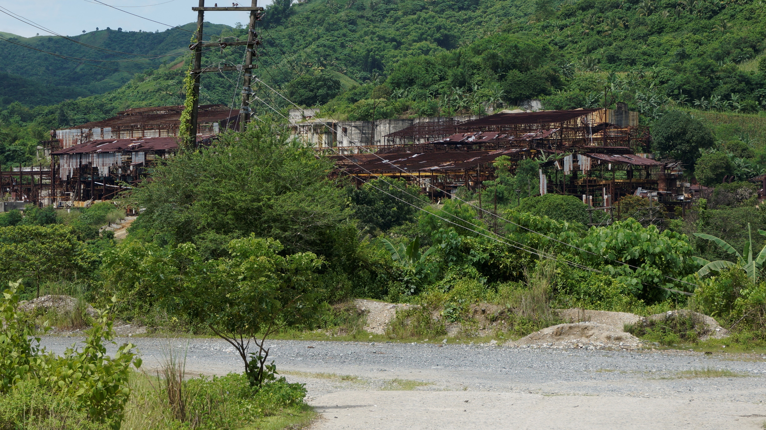
After the mine has left
Presented at the Canadian Association for the Study of International Development (CASID) 2021
June 4, 2021
John Edison Ubaldo¹, Kellyane Levac² and Dominique Caouette²
¹ University of the Philippines - Diliman
² Université de Montréal

Slide 2
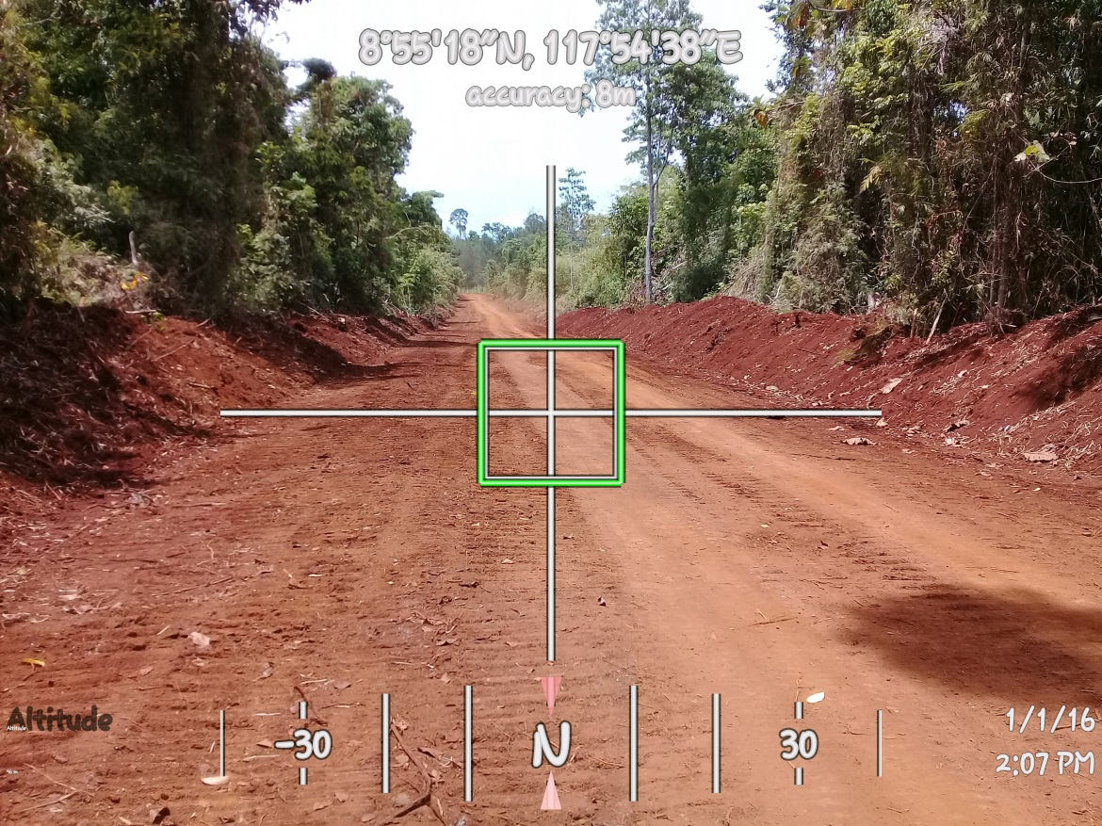
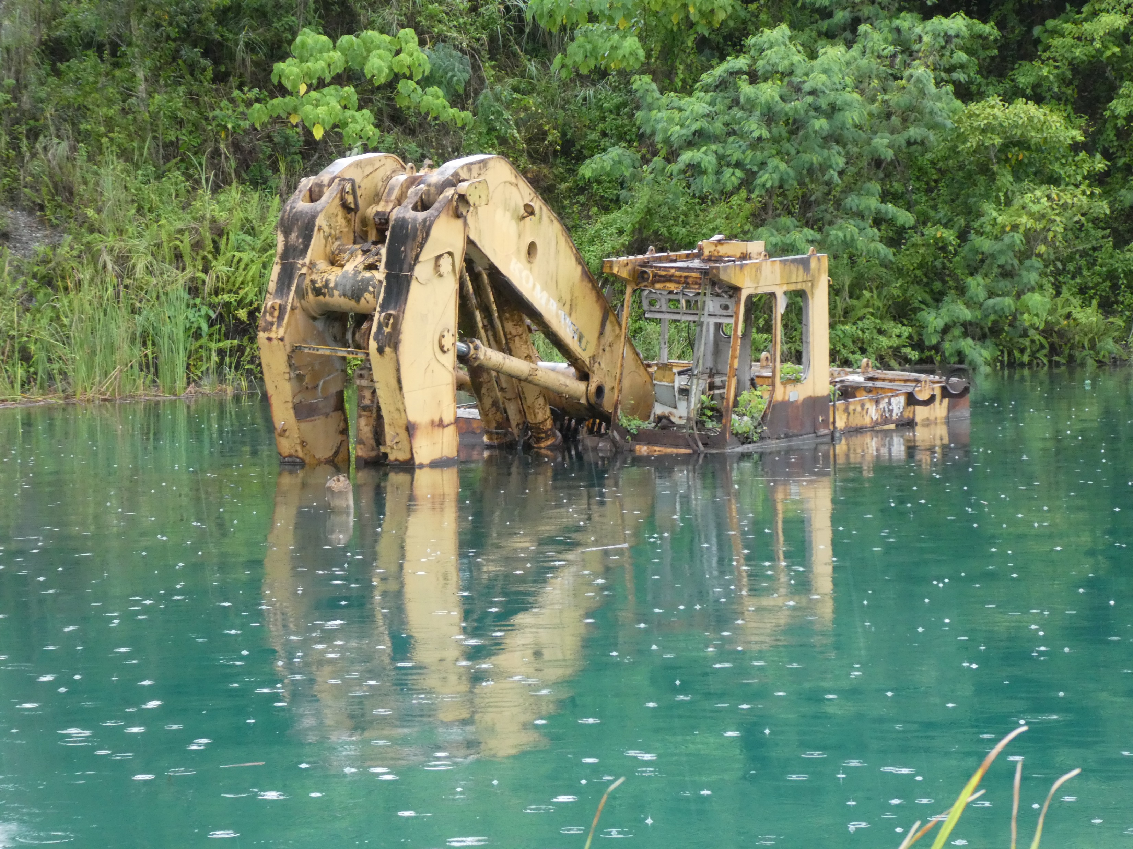
Research Agenda: Point of departure
Point of departure:
Land and natural resources - important areas of contention between the growing pressures of capital accumulation and those who occupy the land or are being dispossessed
Two research projects:
The political economy of resources and violence in the Philippines: a comparative and historical study of three peripheral regions (SSHRC, 2016-2019)
Global minerals and local communities: the challenge of corporate social responsibility (SSHRC, 2018-2024)

Slide 3
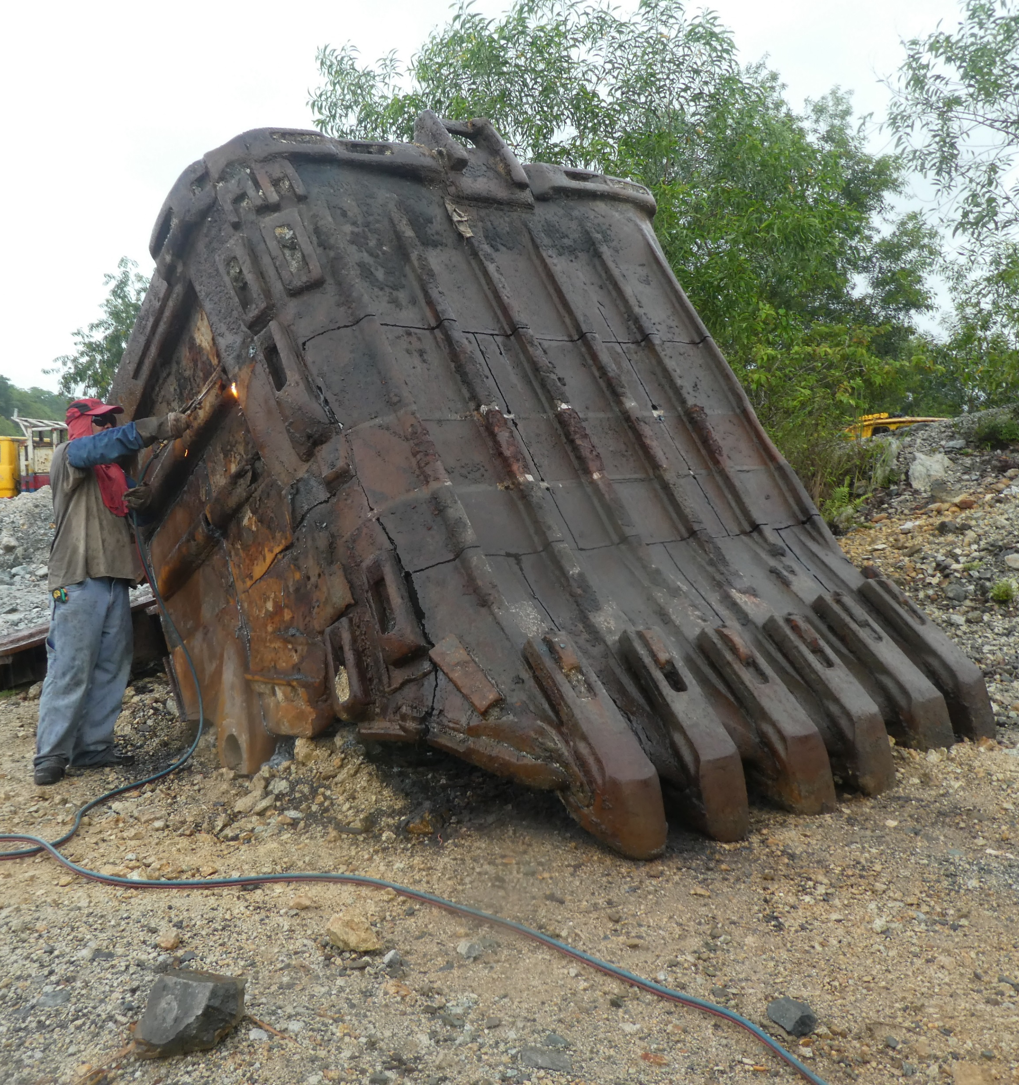
Political Economy, Natural Resources and Corporate Social Responsibility
Goal: Explaining how present political economy of these peripheral regions has been shaped by long-term processes, local-global, domination-resistance and structure-agency dynamics
Argument : Frontier areas have been auspicious to land accumulation, private use of natural resources (forests and mineral) and tourism (in Negros) as national and provincial powers is much diffused and mediated by local power and dynamics.

Slide 4
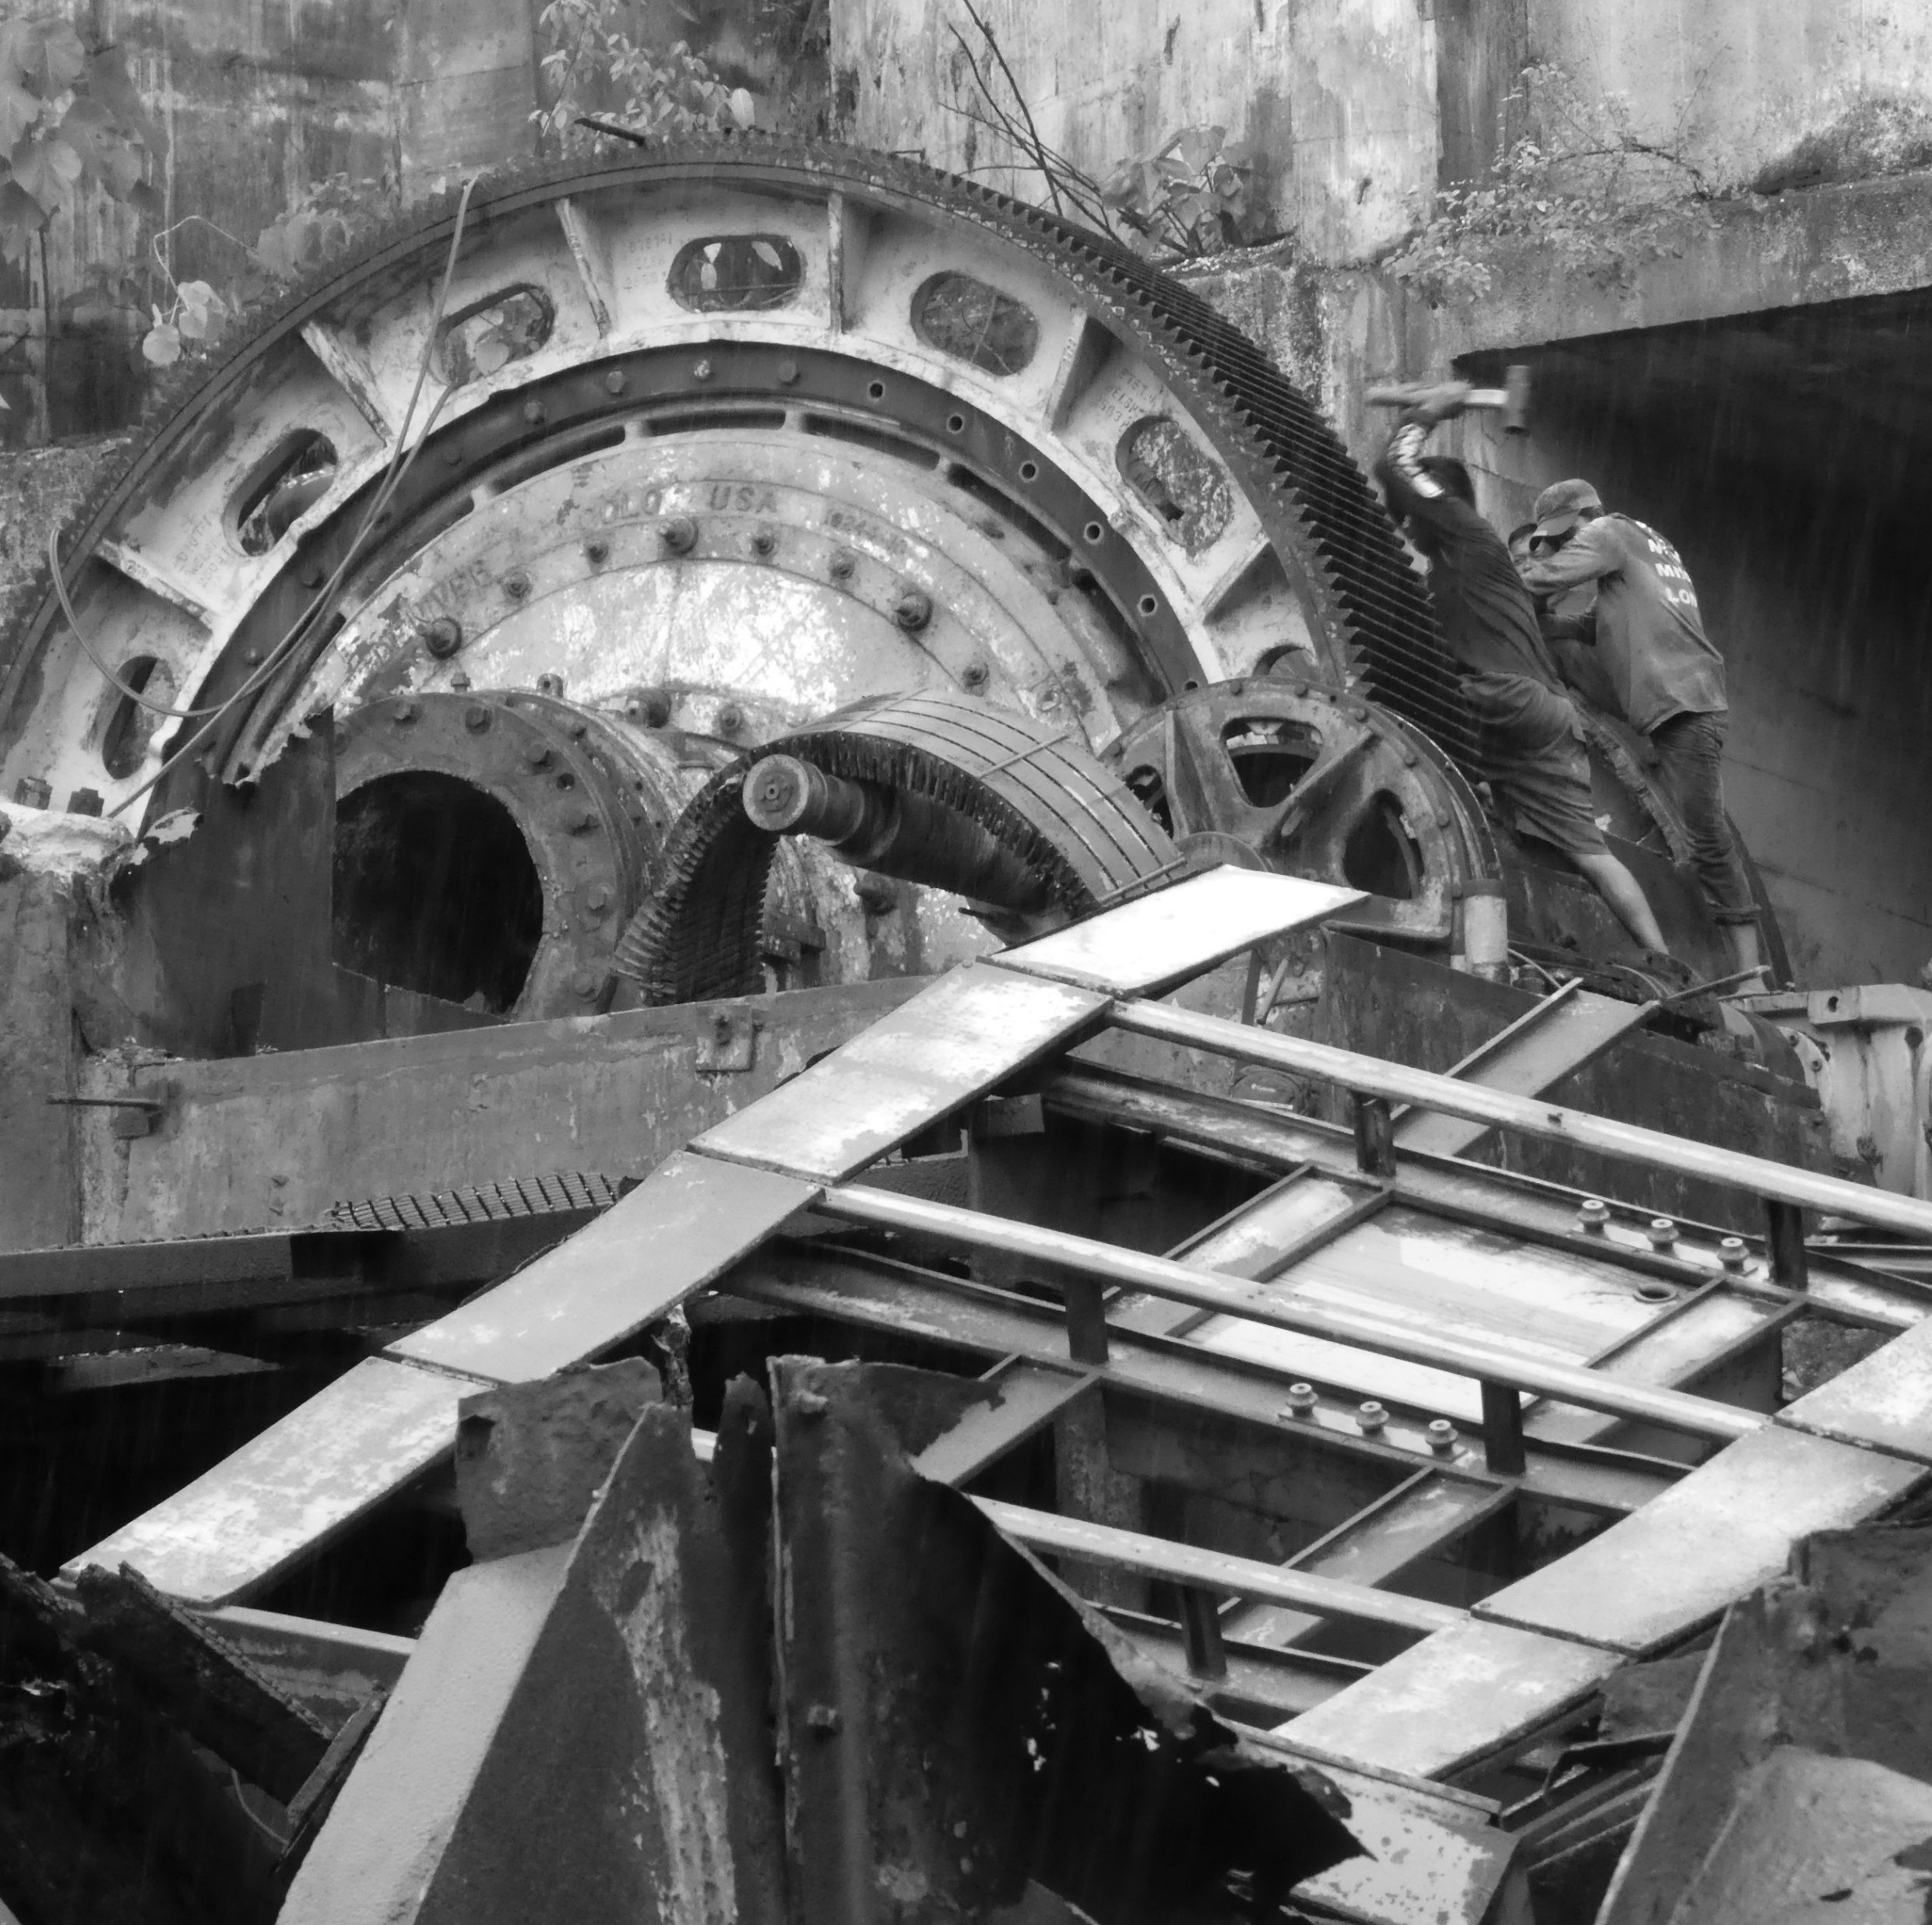
Political Economy, Natural Ressources and Corporate Social Responsibility
Methodology:
Case study approach - Long-term view (dans la durée):
Peripheral – Frontier lands + Local histories, families and power
Examining local-national-transnational connections

Slide 5
Case Study: Southern Negros Hinobaan-Sipalay

Slide 6
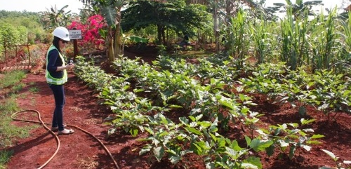
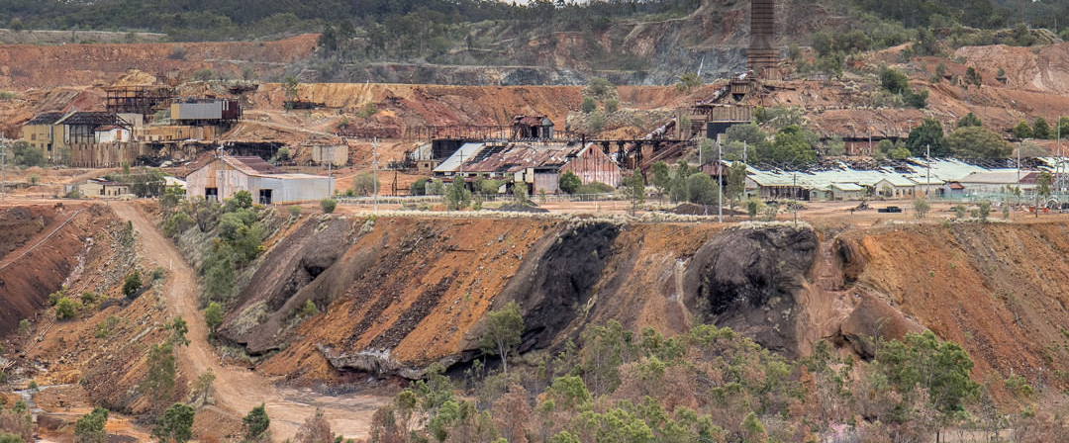
Legacy Mines
Rio Tuba Nickel Mining Corp., Palawan, Philippines
“Lands which have been mined and are now being used for another purpose, or are orphaned, abandoned or derelict and in need of remedial work” (Worall et al., 2009).
Mount Morgan gold mine, Queensland, Australia

Slide 7
Shortfalls of legacy mines
Weak commitment from governments and organizations
No lead entity to supervise
No implementation of mechanisms before, during and after extractive activities
Lack of engagement from stakeholders with local communities
Lack of knowledge from stakeholders about closure plan

Slide 8
Current policies in the Philippines
Mining Act of 1995 – “Contractors and permittees shall technically and biologically rehabilitate the excavated, mined-out tailings covered, and disturbed areas to the condition of environmental safety, as may be provided in the implementing rules and regulations of this Act”
Executive Order No. 79, Section 7
House Bill No. 3644

Slide 9
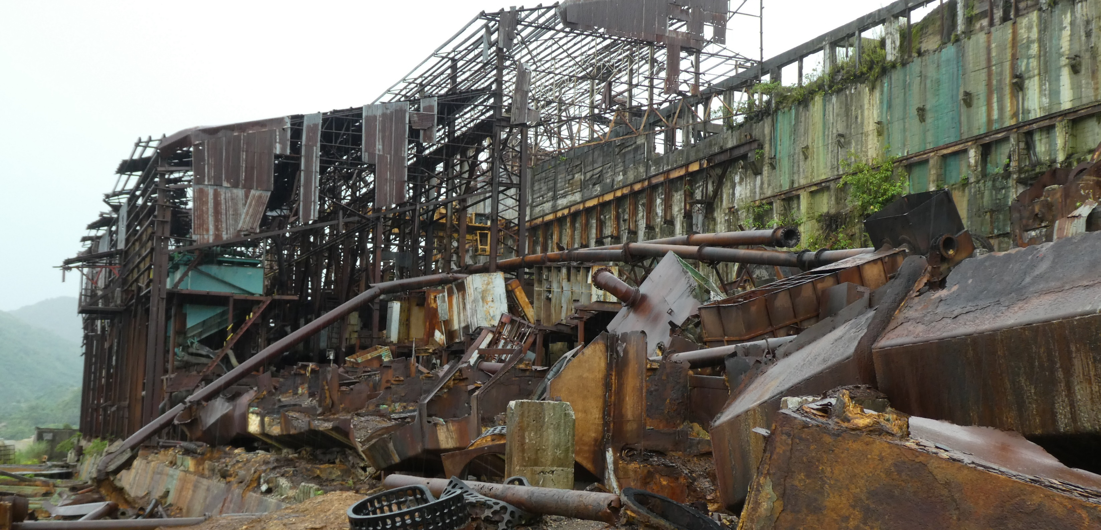
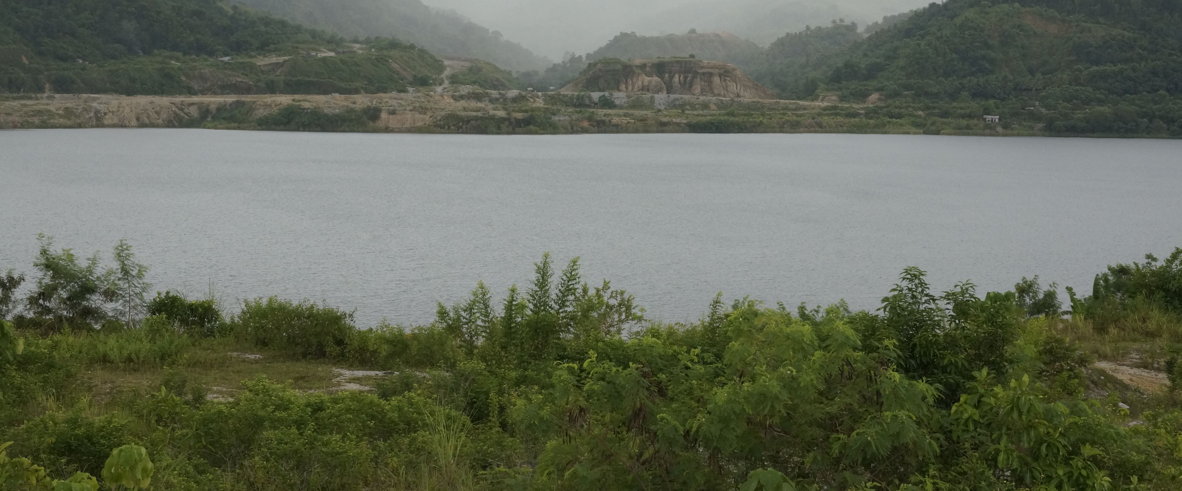
Case Study: Marinduque Mining and Industrial Corporation (1955-1983) / Maricalum Mining Corporation (1984-2001)
Abandoned MMC Refinery Plant
MMIC won the rights to explore, develop and operate in 1955, full-blown operation in 1957
Suspended the operations in 1983 due to lack of capital
Two Philippine state banks foreclosed the mines and renamed in to MMC in 1984
The mines finally shutdown in 2001.
Abandoned MMC open pit

Slide 10
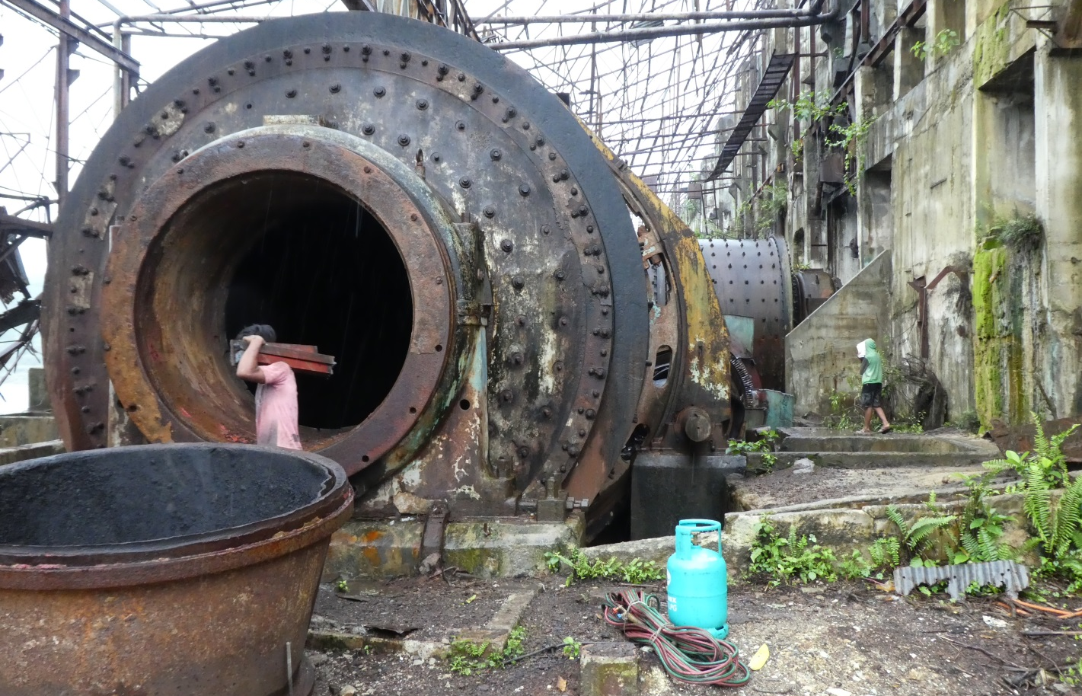
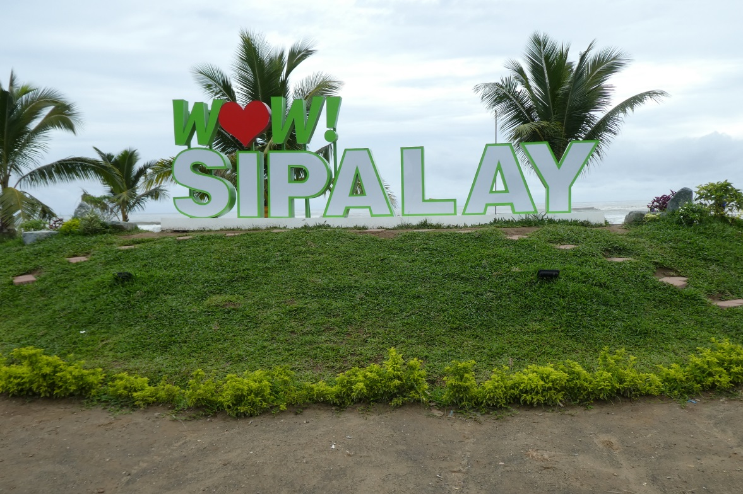
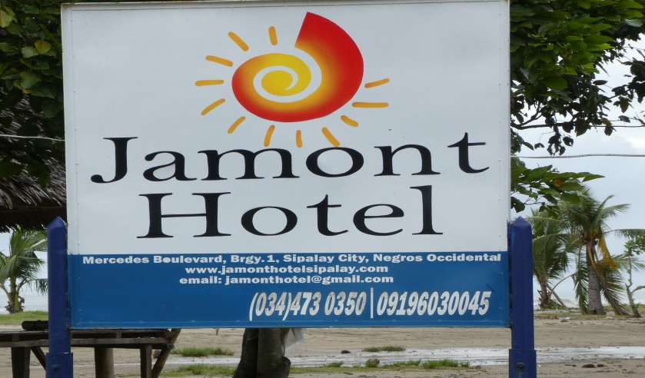
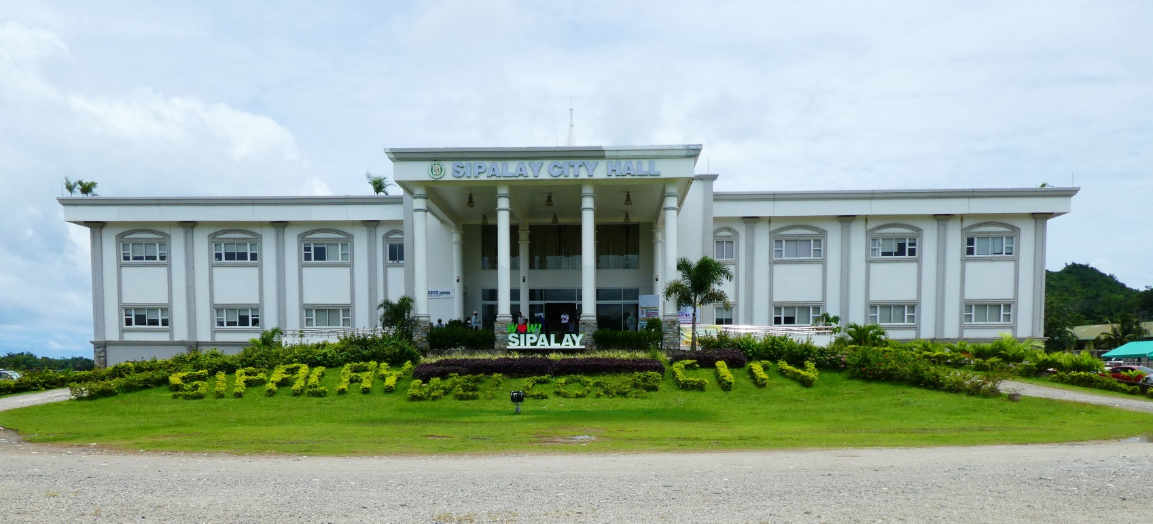

Slide 11
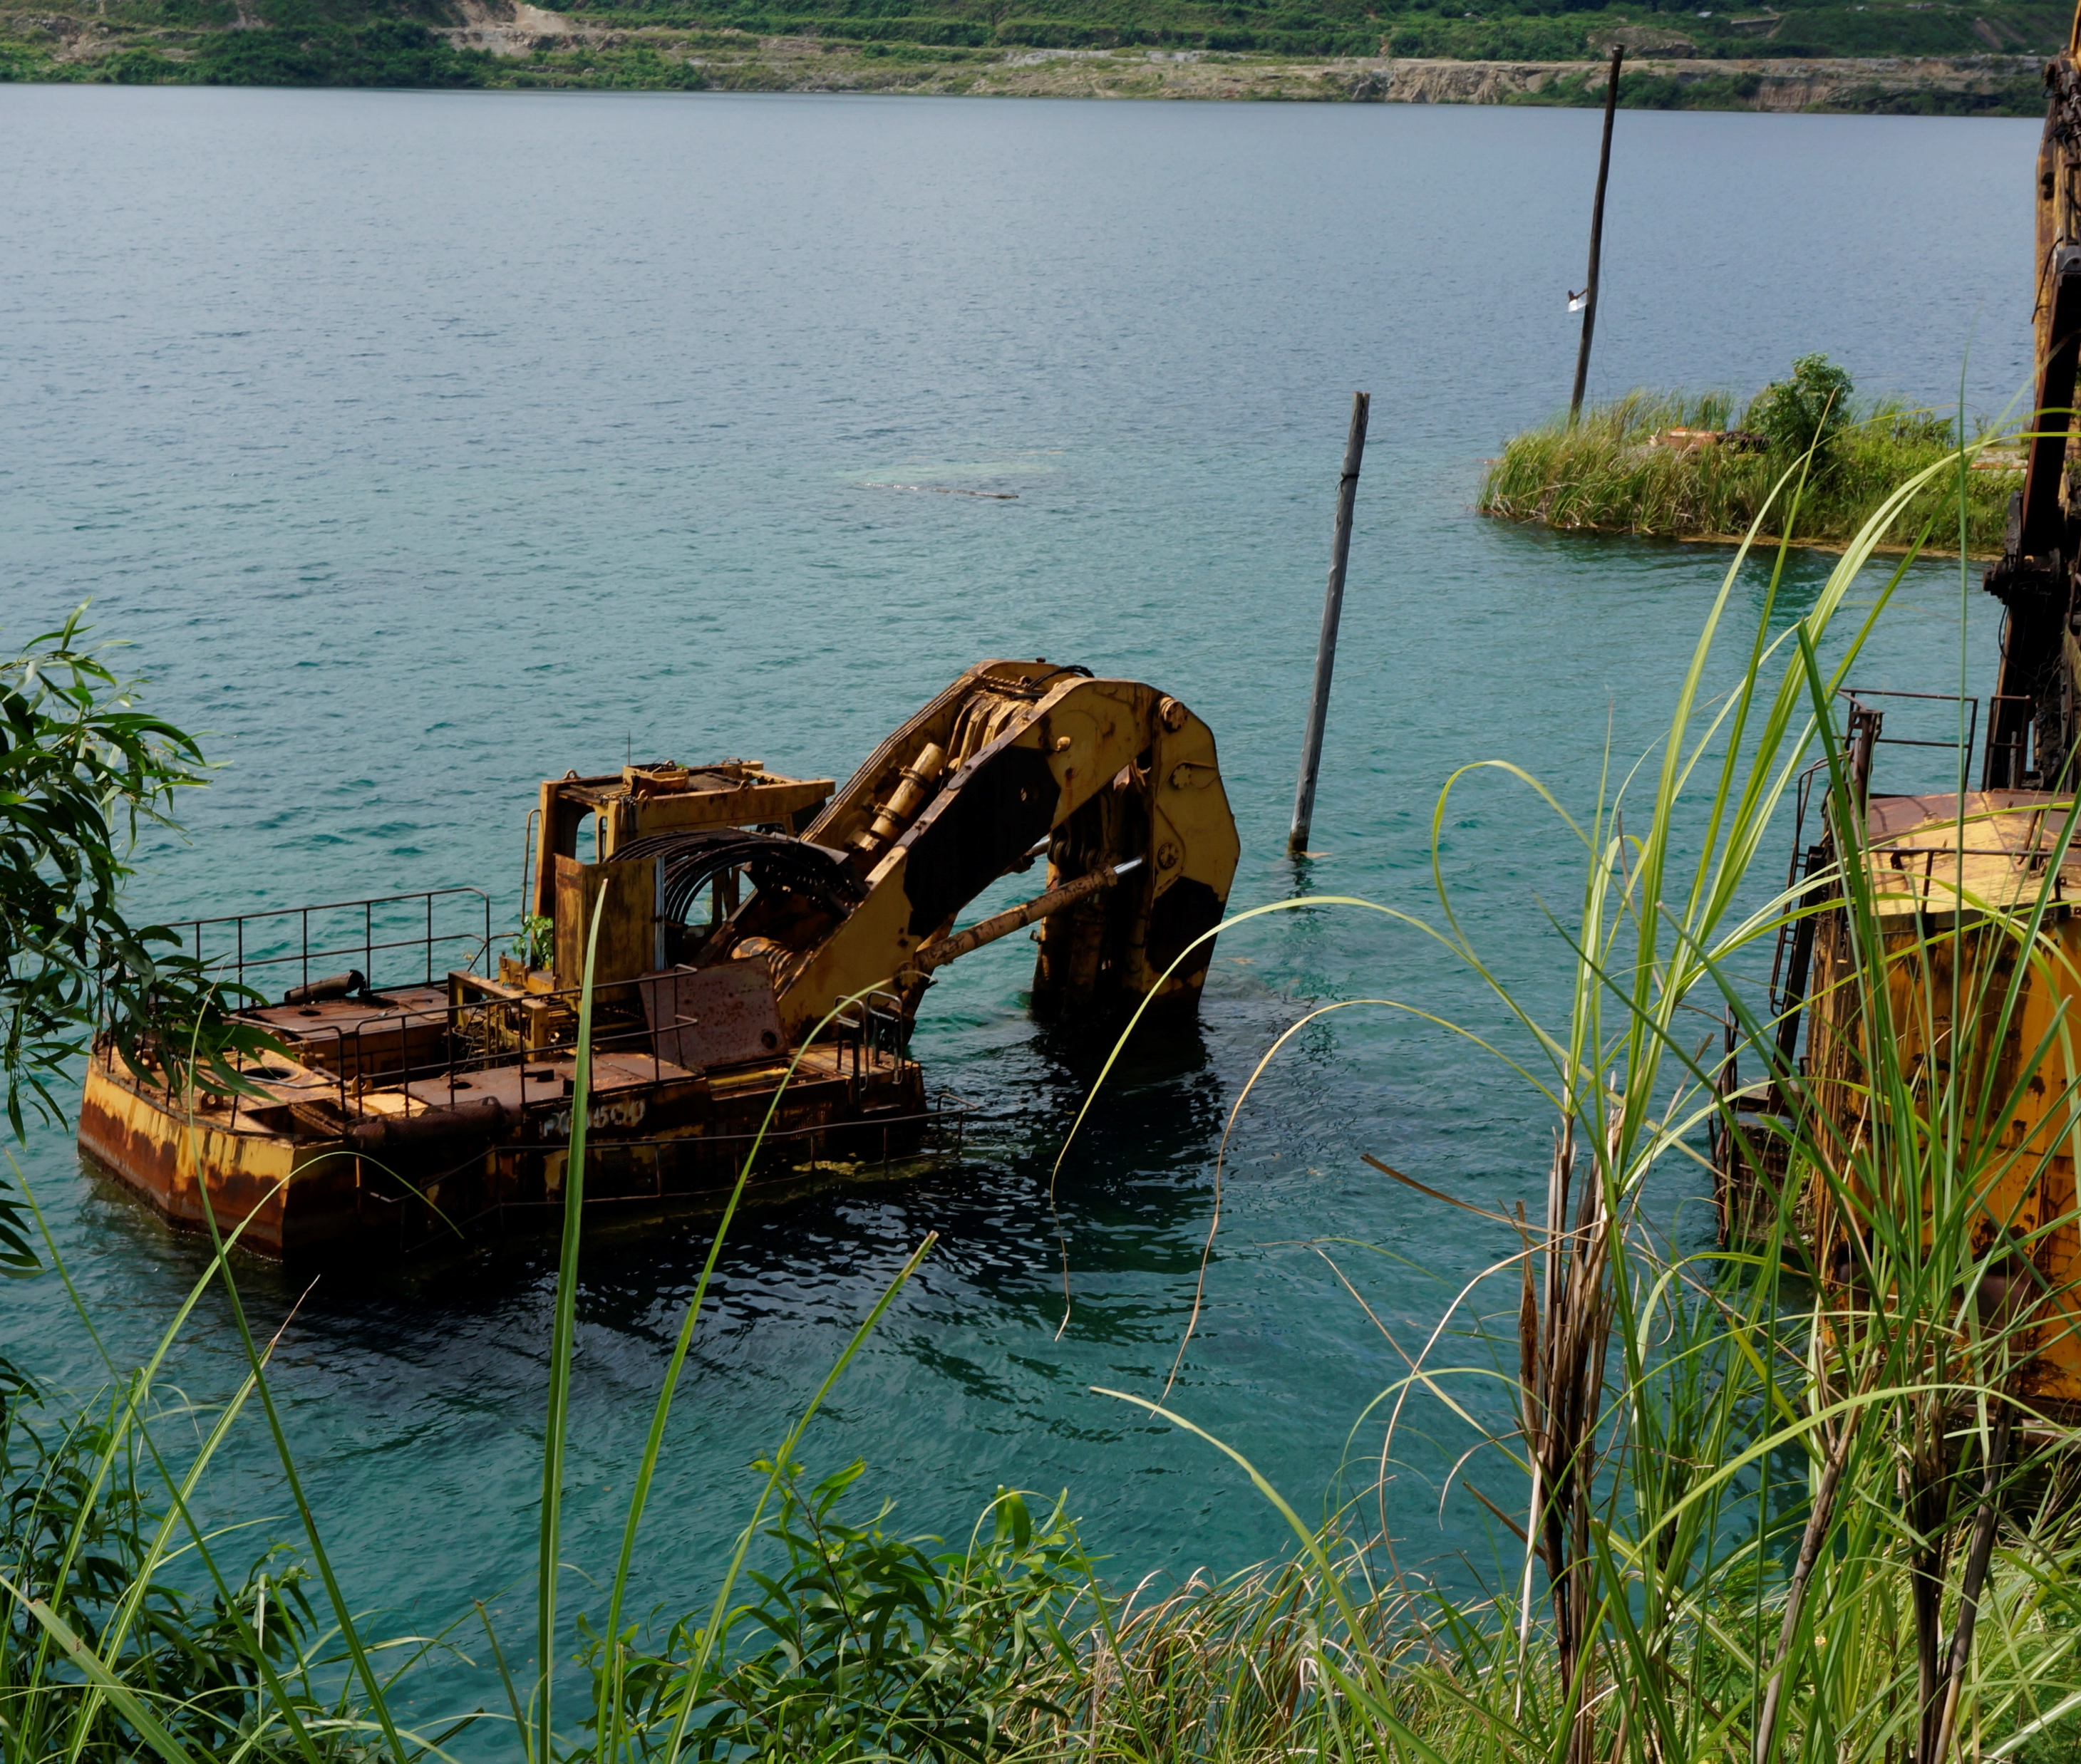
Mitigating the negative impacts of legacy mines - Worall et al. (2009) Sustainability Criteria and Indicators framework
3 “pillars” of sustainability – environment, socio-political and economic criteria
Tool for government planners and communities

Slide 12
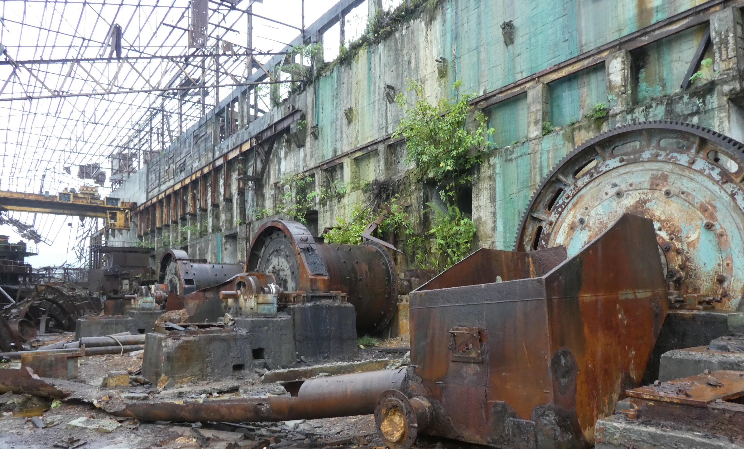
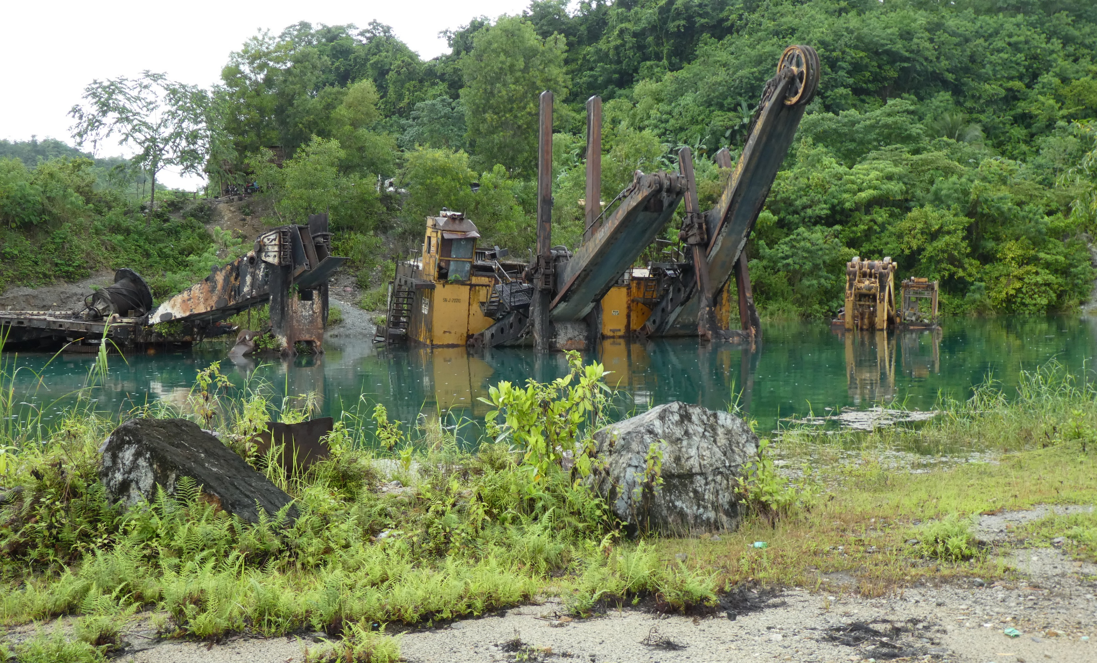
Environmental
Rehabilitation efforts
Land Condition
Off-site impacts

Slide 13
Socio-political
Legislation and Conflict of Interest
Ownership intentions and plans
Health and safety

Slide 14
Economic
Equitable Wealth sharing
Local Economic Contribution
Productive Land Use

Slide 15
Conclusion
The SCI framework has so far shown that the efforts by the mines was there to address some concerns from the local community but the overall impact outweighed the positives that they brought to Sipalay. The sustainability aspect of the programs of MMC was a complete failure.
As such, there should be more legacy mine studies in the Philippines to identify gap in policies and advocate for more sustainable mining practices.
Major limitation of CSR does not address – after the mine closed

Slide 16
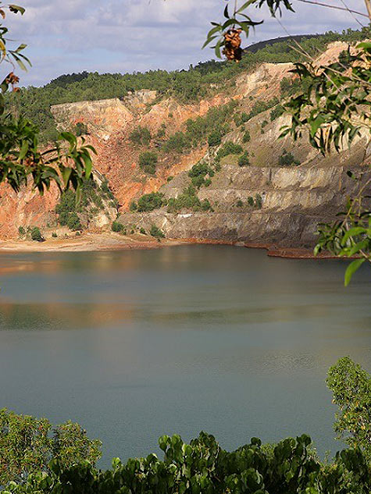
Marcopper / Placer Dome (1969-1996) - Barrick Gold (2006-…) Marinduque
Photo 1, 2 and 3: Erik de Castro (2019); Photo 4: Keith Schneider (2017)

